Slide 1
Programming Assignment 1 (1:7)
Build a Dictionary on top of a
Bag built on top of an
Array of objects → KVpairs (key/value pairs)
Your dictionary should be able to hold at least 10 items.
I have given you the templates for a
Bag (ADT and implementation)
Dictionary (ADT and implementation)
KV pair (implementation)
Do not modify the ADT templates or the KVPair class.

Slide 2
Programming Assignment 1 (2:7)
Start by writing your Approach document first. I recommend you use an incremental approach
Build the Bag first and get it working
Then build the Dictionary using the Bag and get it working.
Build your program one function at a time.
When you finish your Bag and then Dictionary show that it works using the bagtestmain.cpp file I’ve provided for you.

Slide 3
Programming Assignment 1 (3:7)
What is a Bag
Think of a grocery bag
Bags fill up from bottom to top (like a stack)
Unlike a stack, a bag provides access to all of the contents, not just the items at the top
To find something in a bag you start looking from the top
See BagADT.h for Bag operations

Slide 4
Programming Assignment 1 (4:7)
Dictionary
Used for storing key/value records
Provides operations for
Storing,
Finding, and
Removing records from a collection
Comparable objects
Since Find is the fundamental operation of a dictionary we need a key to search on
For the English dictionary the key is the word itself (Key) and the definition consists of the word and its definition (Value)
Dictionaries use a Key/Value pair; the key provides the “comparable object” used by Find

Slide 5
Programming Assignment 1 (5:7)
Note: You only get credit for the methods you demonstrate in your testing.
In implementing your Dictionary you must use the available bag operations to implement your dictionary operations.
Bag Operations
AddItem(E)
Remove(E)
RemoveTop(E)
Find(E)
EmptyBag()
+= operator overload (adds an item)
BagCapicity()
Dictionary Operations:
Clear()
Insert(E)
Remove(E)
RemoveAny(E)
Find(E)
Size()
Notes:
1/26/2015: Note that you’ve changed the Bag ADT so that remove(const &E) is no longer a constant to make the method similar to find().

Slide 6
Programming Assignment 1 (6:7)
KVPair.h provides the template (this is an implementation and not an ADT) for creating a key/value pair used by both the Bag and Dictionary. You do not need (nor are you allowed to) make any changes to it.
You are to use the following KV pair types for this assignment:
<int, string>
<string, int>

Slide 7
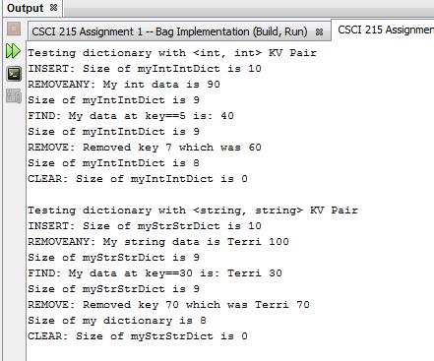
Programming Assignment 1 (7:7)
Example dictionary test run
In this example I am doing <int, int> and <string, string> tests.
You must do <int, string> and <string, int> tests.
Notes:
My test run only shows my Dictionary run, but if you cannot get your dictionary to work you must show your Bag test runs that demonstrate every working function. You only get credit for the functions that work and to get any credit at all you need to get one or more of the Bag functions working.

Slide 8
Dictionaries & KVPairs
For more information on Dictionaries and the use of KVPairs read section 4.4 of your text
There you will find both details and usage examples.

Slide 9
Assignment 1 Comments
You must implement the ADTs by inheriting them – you cannot modify them
class ABag : public bagADT { }
class BDictionary : public dictionaryADT { }
As a minimum you must
Demonstrate one or more working bag operations to get any credit for this assignment and
You will not get credit, even if one or more ADT operations are implemented, if your implementation does not inherit the ADTs.
If you use the implementation files I’ve provided, the inheritance issue is taken care of for you.
Notes:
Why do you think inheritance is so important here?
So that users can declare their types to be of the ADT type, which keeps their program loosely coupled to the implementation details.
The ADT acts as a contract that your implementation is required to implement. The compiler will tell you if you are not upholding your end of the contract.

Slide 10
Style Comments
You do not have to separate declaration and implementation into header and .cpp files
Put declaration and implementation both in the header file
I expect to see
Self-documenting code
Good use of white space and indentation
Liberal use of comments
Easy to read and understand
Style and your ability to follow instructions is worth 30% of the assignment.

